Slide 1

Name : Pooja.M
Project Title: Greeting Website using AWS Cloud Services
Role: Cloud Engineer

Slide 2

🧩Problem Statement :
Use AWS CDK to provision S3 buckets, API Gateway, and Lambda functions to build a simple web application with automated infrastructure deployment.
🧩Project Goal :
To create a serverless greeting website where users can enter their name and receive a personalized greeting along with a random “quote of the day.”
All resources are deployed and managed through AWS CDK.
☁️ AWS Services Used:
AWS CDK — Infrastructure as Code (IaC) tool to automate provisioning
AWS Lambda — Serverless backend to process greetings and generate quotes
Amazon API Gateway — Exposes REST API endpoint to connect frontend and backend
Amazon S3 — Hosts the React frontend as a static website

Slide 3
🧱Architecture Diagram :
USER
REACT APP (S3)
API GATEWAY
LAMBDA FUNCTION
Sends Name
Collect Name & Calls API
Triggers
Lambda
Sends Response
🖼️ Architecture Overview:
Frontend (React): Hosted on S3, collects user input (name) and sends request to backend API.
API Gateway: Receives request from frontend, triggers the Lambda function.
AWS Lambda: Generates a personalized greeting and picks a random quote.
Response: Lambda returns the data via API Gateway → React app displays greeting + quote

Slide 4
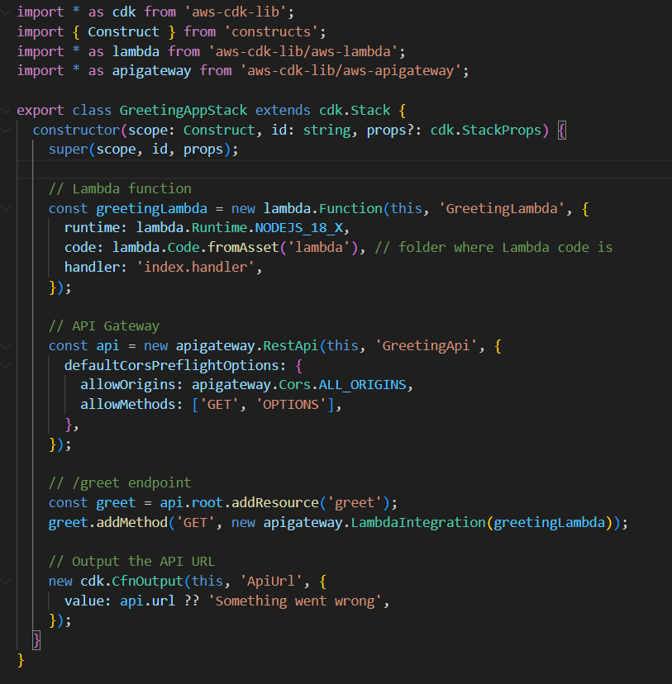
⚙️AWS CDK Setup (Infrastructure as Code) :
📌Explanation :
Defines Lambda function using Node.js 18 runtime and code from the “lambda” folder..
Creates API Gateway with built-in CORS support.
Adds a /greet endpoint linked to the Lambda function.
Outputs API URL automatically after deployment
Entire setup deployed with a single command
-cdk deploy.

Slide 5
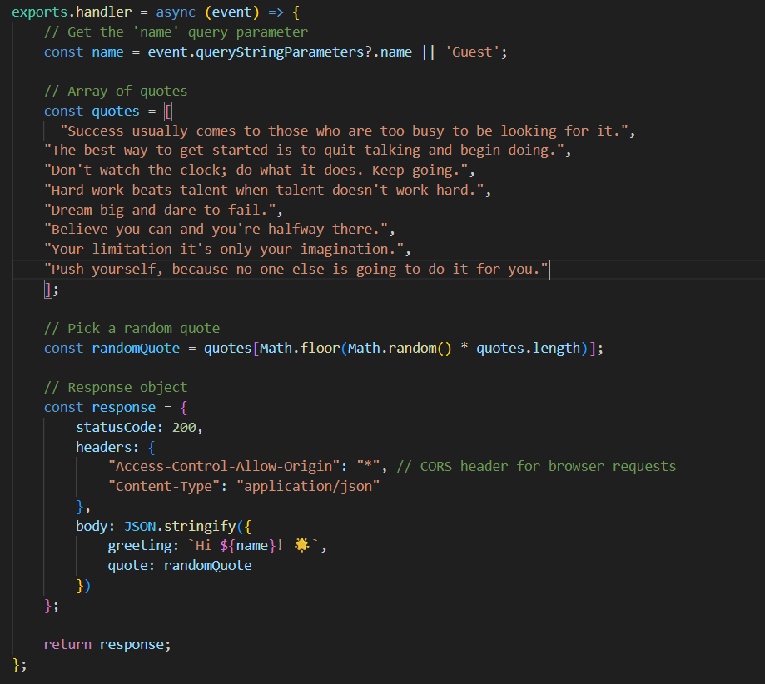
⚙️Backend (AWS Lambda + API Gateway)
📌Explanation :
Get user input:
Retrieves the name parameter from the API request (event.queryStringParameters)
Defaults to "Guest" if no name is provided
Quotes array:
Contains multiple motivational quotes.
Picks one randomly each time the function is invoked.
Prepare Response:
Creates a JSON object with greeting and selected quote
Includes CORS header so the frontend can call the API from any domain
Return Response:
Sends statusCode 200 along with JSON payload back through API Gateway
Frontend receives this data and displays the greeting + quote dynamically.

Slide 6
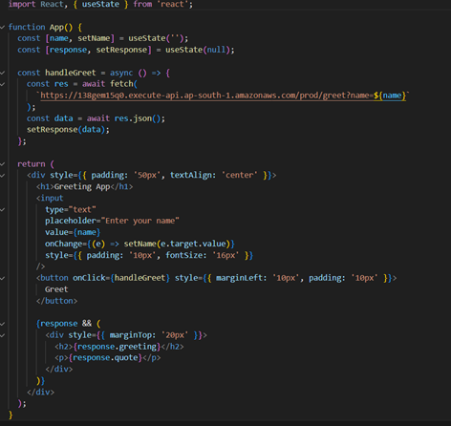
💻 Frontend (React + S3 Hosting) :
📌Explanation :
State Management:
name stores user input.
response stores data returned from the API (greeting + quote)
Handle Button Click (handleGreet):
Calls API Gateway endpoint with the user’s name as a query parameter.
Converts API response to JSON and updates response state
Render UI:
Input box to type the name.
Greet button triggers API call.
Displays greeting and quote dynamically when response is received.

Slide 7
🎯 Conclusion:
Built a serverless greeting website with dynamic quotes.
Full-stack app deployed entirely on AWS Free Tier.
Infrastructure automated using AWS CDK.
Demonstrated end-to-end cloud deployment skills, integrating frontend, backend, and hosting seamlessly.
💡 Learnings:
Hands-on experience with React frontend, AWS Lambda, API Gateway, and S3 hosting.
Learned CORS handling for frontend-backend integration.
Understood serverless architecture and Infrastructure as Code (IaC).
Gained confidence in end-to-end cloud project deployment.

